Slide 1

DATA ANALYTICS CASE STUDY
Sales
Performance
Analysis
Business Intelligence · Pricing · Profitability
A single retail product · 1,053 trading days · Dec 2013 – Nov 2016
Portfolio project · React · TypeScript · Recharts dashboard

Slide 2
01 · CONTEXT
Business Problem
Analyse the daily sales performance of a single retail product to identify pricing trends, profitability drivers, promotional opportunities and actionable business insights for senior management.
Is the product profitable?
Revenue is healthy at R186.91M, yet cumulative gross profit is negative.
Is pricing keeping pace with cost?
Unit cost has repeatedly overtaken selling price across the window.
R186.91M
-R7.12M
1,053
Total sales
Gross loss
Trading days
Does volume compensate?
Demand behaviour is tested against price to check elasticity.
Sales Performance Analysis · Business Problem
02

Slide 3
02 · DATA
Dataset Overview
Daily transactional records for one retail product, plus metrics derived during analysis.
Source fields
Derived metrics
Date
Daily trading date (Dec 2013 – Nov 2016)
Unit Selling Price
Sales ÷ Quantity Sold
Sales
Revenue booked for the day (ZAR)
Unit Cost Price
Cost of Sales ÷ Quantity Sold
Gross Profit
Sales − Cost of Sales
Cost of Sales
Landed cost of goods sold (ZAR)
Gross Profit Margin
Gross Profit ÷ Sales
Quantity Sold
Units moved on the day
Gross Profit per Unit
Gross Profit ÷ Quantity Sold
Grain: one row per trading day · 151 weeks · 36 calendar months · no missing dates after validation
Sales Performance Analysis · Dataset Overview
03

Slide 4
03 · METHOD
Data Cleaning & Feature Engineering
1
2
3
4
5
Ingest
Validate
Clean
Engineer
Aggregate
Load daily transactional extract
Type, range & date-continuity checks
Missing / zero-quantity value handling
Calculated price & margin columns
Weekly, monthly & yearly KPI roll-ups
Validation
Missing values
Derived KPIs
Confirmed 1,053 continuous trading days with no duplicate dates and no negative quantities.
Rows with zero quantity excluded from per-unit price metrics to avoid divide-by-zero distortion.
Unit selling price, unit cost price, gross profit, margin % and profit per unit calculated per day.
Sales Performance Analysis · Data Preparation
04

Slide 5
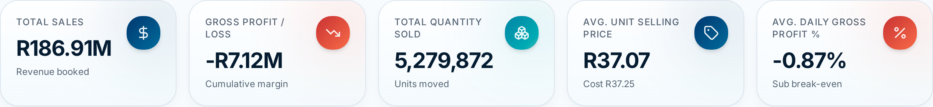
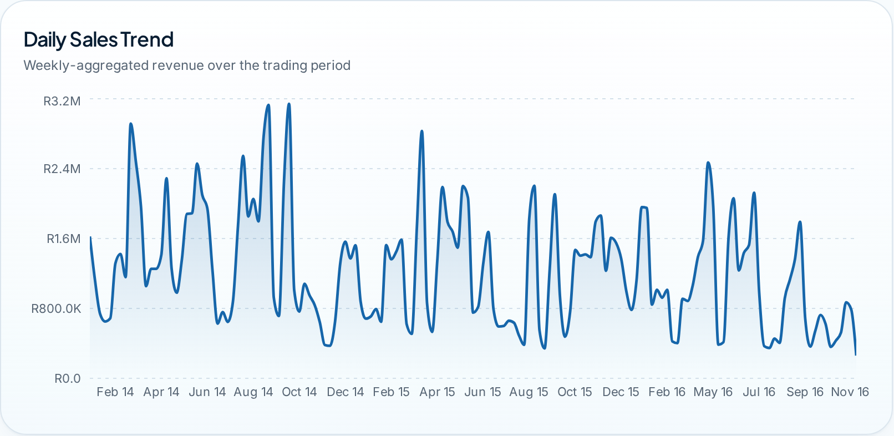
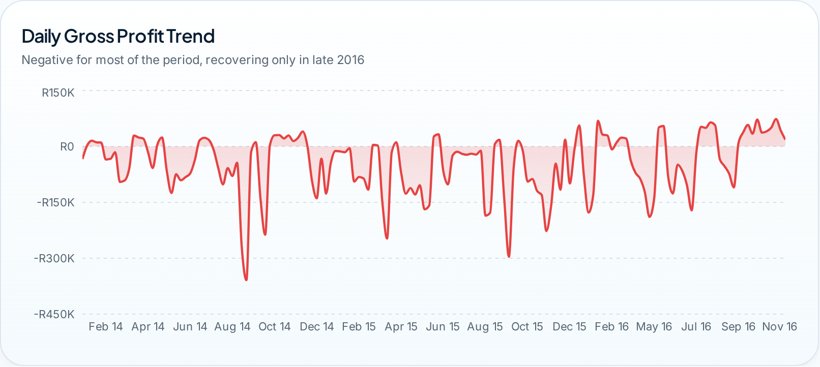
04 · PAGE 1
Executive Dashboard
Daily Sales Trend
Daily Gross Profit Trend
Key findings
Revenue peaks near R7M/week in mid-2014, then decays through 2016.
Gross profit sits below zero for most of the window.
Volume fell 43% from 2014 to 2016.
Sales Performance Analysis · Executive Overview
05

Slide 6
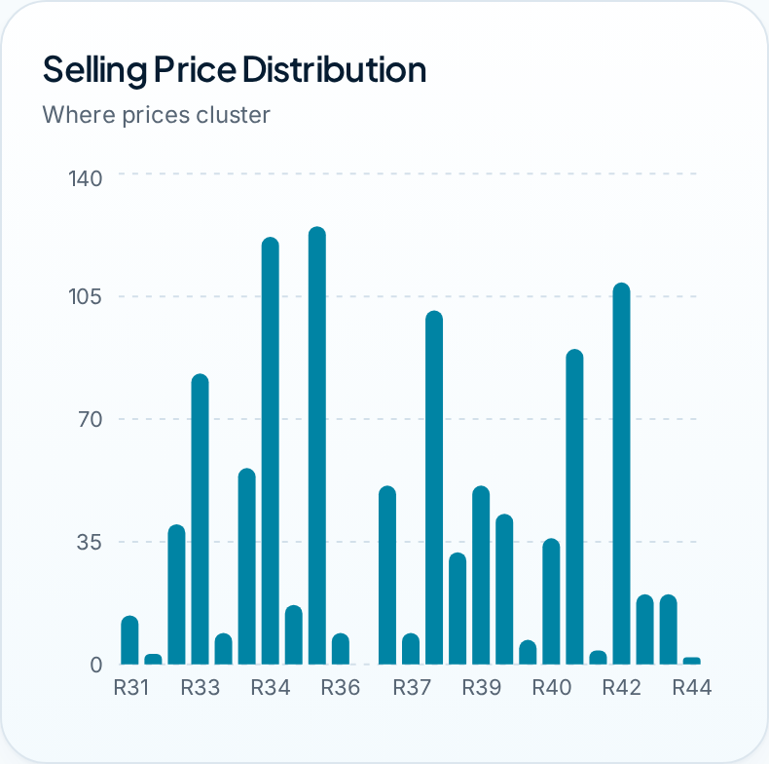
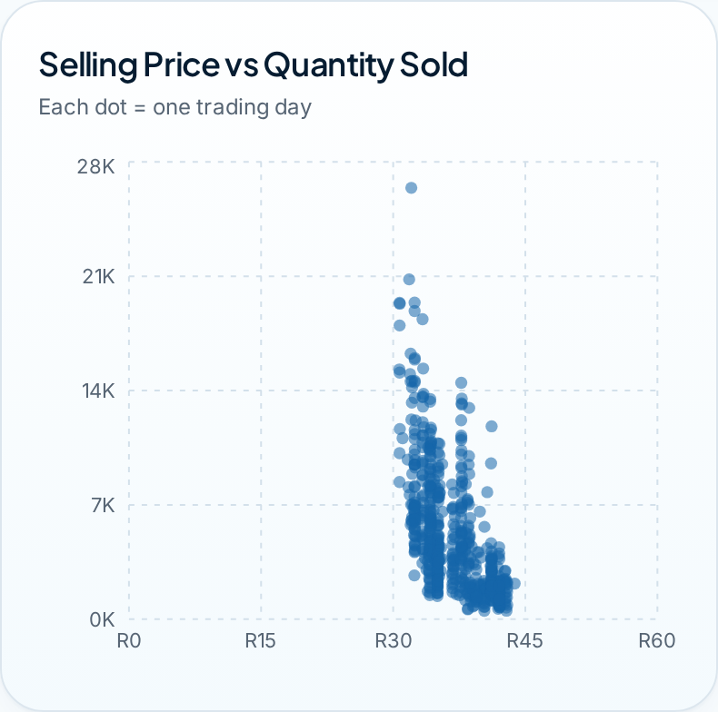
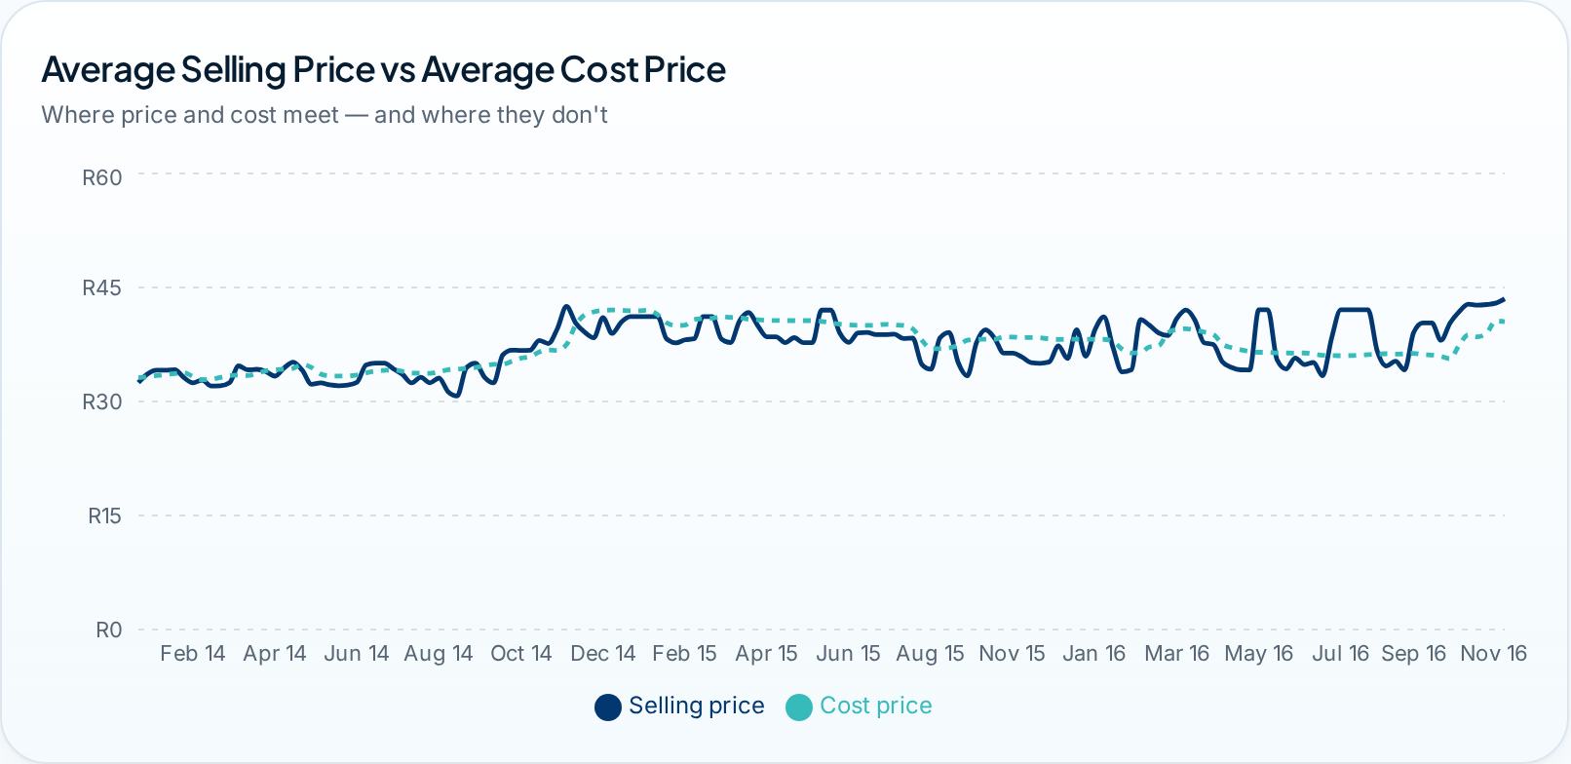
05 · PAGE 2
Pricing Analysis
Selling Price vs Cost Price
Selling Price Distribution
Price vs Quantity Sold
Pricing consistency
Demand sensitivity
Price vs volume
Selling price drifted from R32.60 to R42.98 (a 32% band) with no sharp shocks — pricing is stable but consistently trails procurement cost.
The scatter shows units falling as price rises above ~R40, evidence of genuine price elasticity rather than pure seasonality.
2015 combined the highest average cost (R39.74) with a 24% volume drop, producing the worst annual loss of R3.90M.
Sales Performance Analysis · Pricing Analysis
06

Slide 7
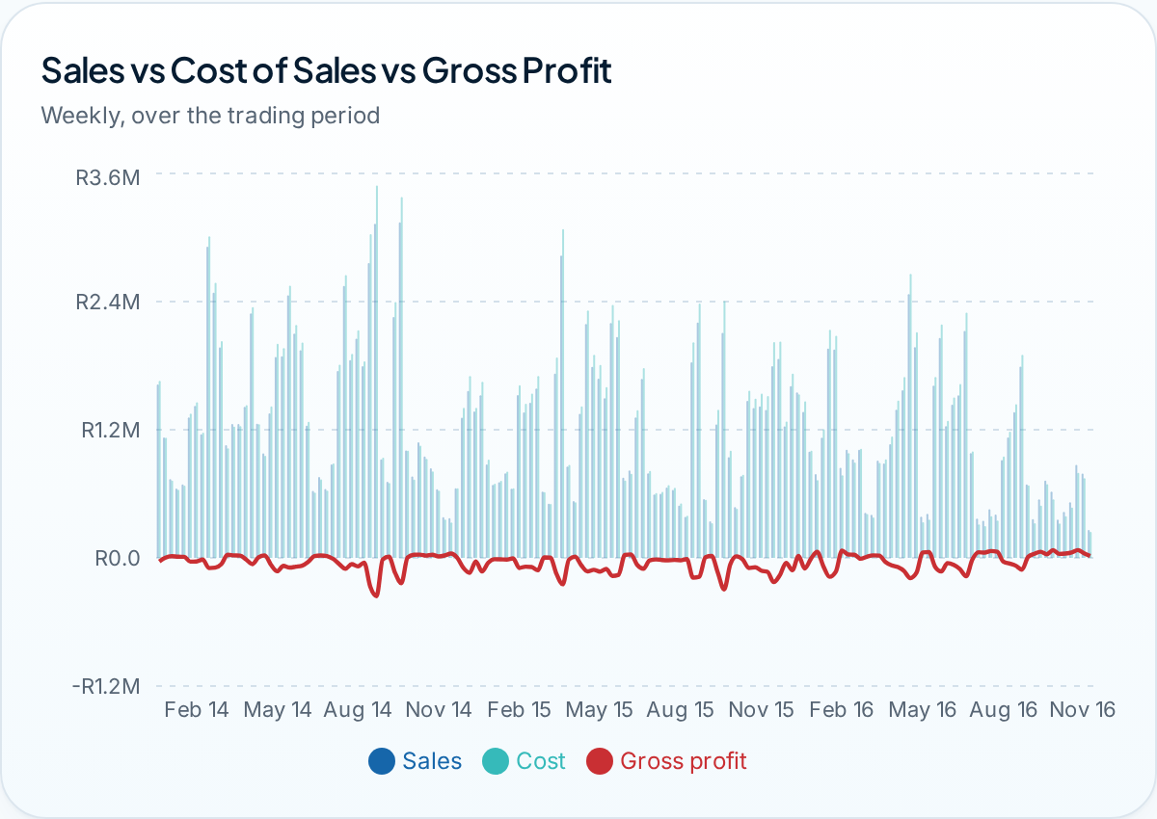
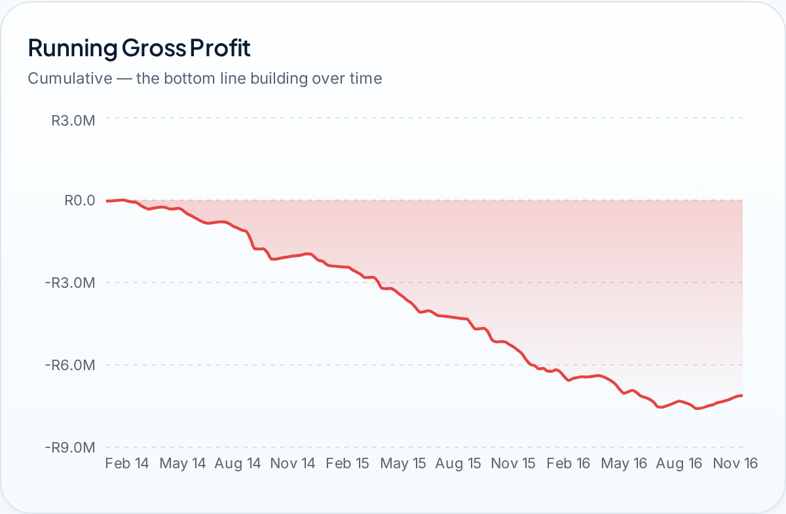
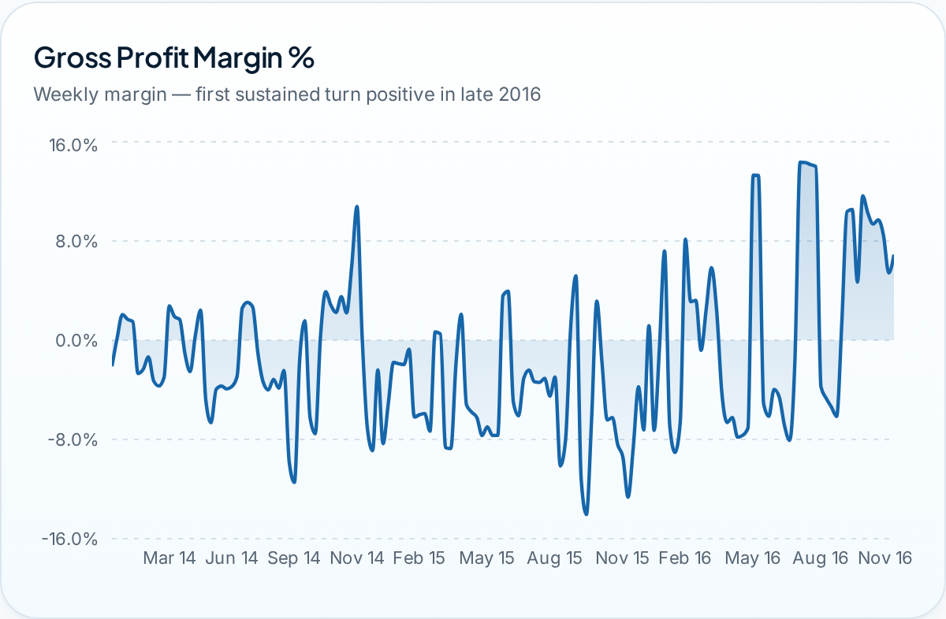
06 · PAGE 3
Profitability Analysis
Sales vs Cost of Sales vs Gross Profit
Running Gross Profit
Gross Profit Margin
Loss periods
Recovery signal
Trajectory
Only 8 of 36 months closed in profit. Nov-2015 was the worst month at -R0.60M, with unit cost R2.81 above selling price.
Oct-2016 delivered the strongest month at +R0.22M, with price at R41.63 against cost of R37.48.
Annual loss narrowed from -R3.90M (2015) to -R0.94M (2016) as pricing discipline improved.
Sales Performance Analysis · Profitability & Performance
07

Slide 8
07 · FINDINGS
Key Insights
01
02
03
Revenue without return
Cost outruns price
Demand is contracting
R186.91M of sales produced a R7.12M cumulative gross loss — scale is not the constraint, margin is.
Average unit cost of R37.25 exceeds the R37.07 average selling price, so the base unit economics are negative.
Units fell from 2.25M (2014) to 1.29M (2016) while average price rose R3.94 — clear elasticity pressure.
04
05
06
Losses are concentrated
Margin is improving
Profitable months are rare
2015 alone contributed R3.90M of the total loss, driven by the highest cost year on record.
2016 is the only year where price (R38.52) exceeded cost (R37.21); Q4-2016 turned sustainably profitable.
Just 8 of 36 months closed above break-even, and 5 of those fall in the final 12 months of trading.
Sales Performance Analysis · Key Insights
08

Slide 9
08 · ACTION
Business Recommendations
1
Monitor pricing strategy
Introduce a weekly price-vs-cost guardrail; escalate whenever unit cost closes within R1.00 of selling price.
Immediate
2
Review product costs
Renegotiate landed cost on the 2015 supply terms that drove the R3.90M annual loss.
Immediate
3
Optimise promotional pricing
Cap discount depth: revenue-led promotions in 2014–15 grew volume but deepened the loss.
Near term
4
Improve gross profit margin
Target a sustained margin floor of +3%, replicating the Oct-2016 price/cost spread of R4.15.
Near term
5
Track pricing elasticity
Formalise the price/volume scatter into a monthly elasticity read before any price move.
Ongoing
Expected effect: closing the R0.18 price-to-cost gap on 1.29M annual units returns roughly R0.23M of gross profit per year.
Sales Performance Analysis · Recommendations
09

Slide 10
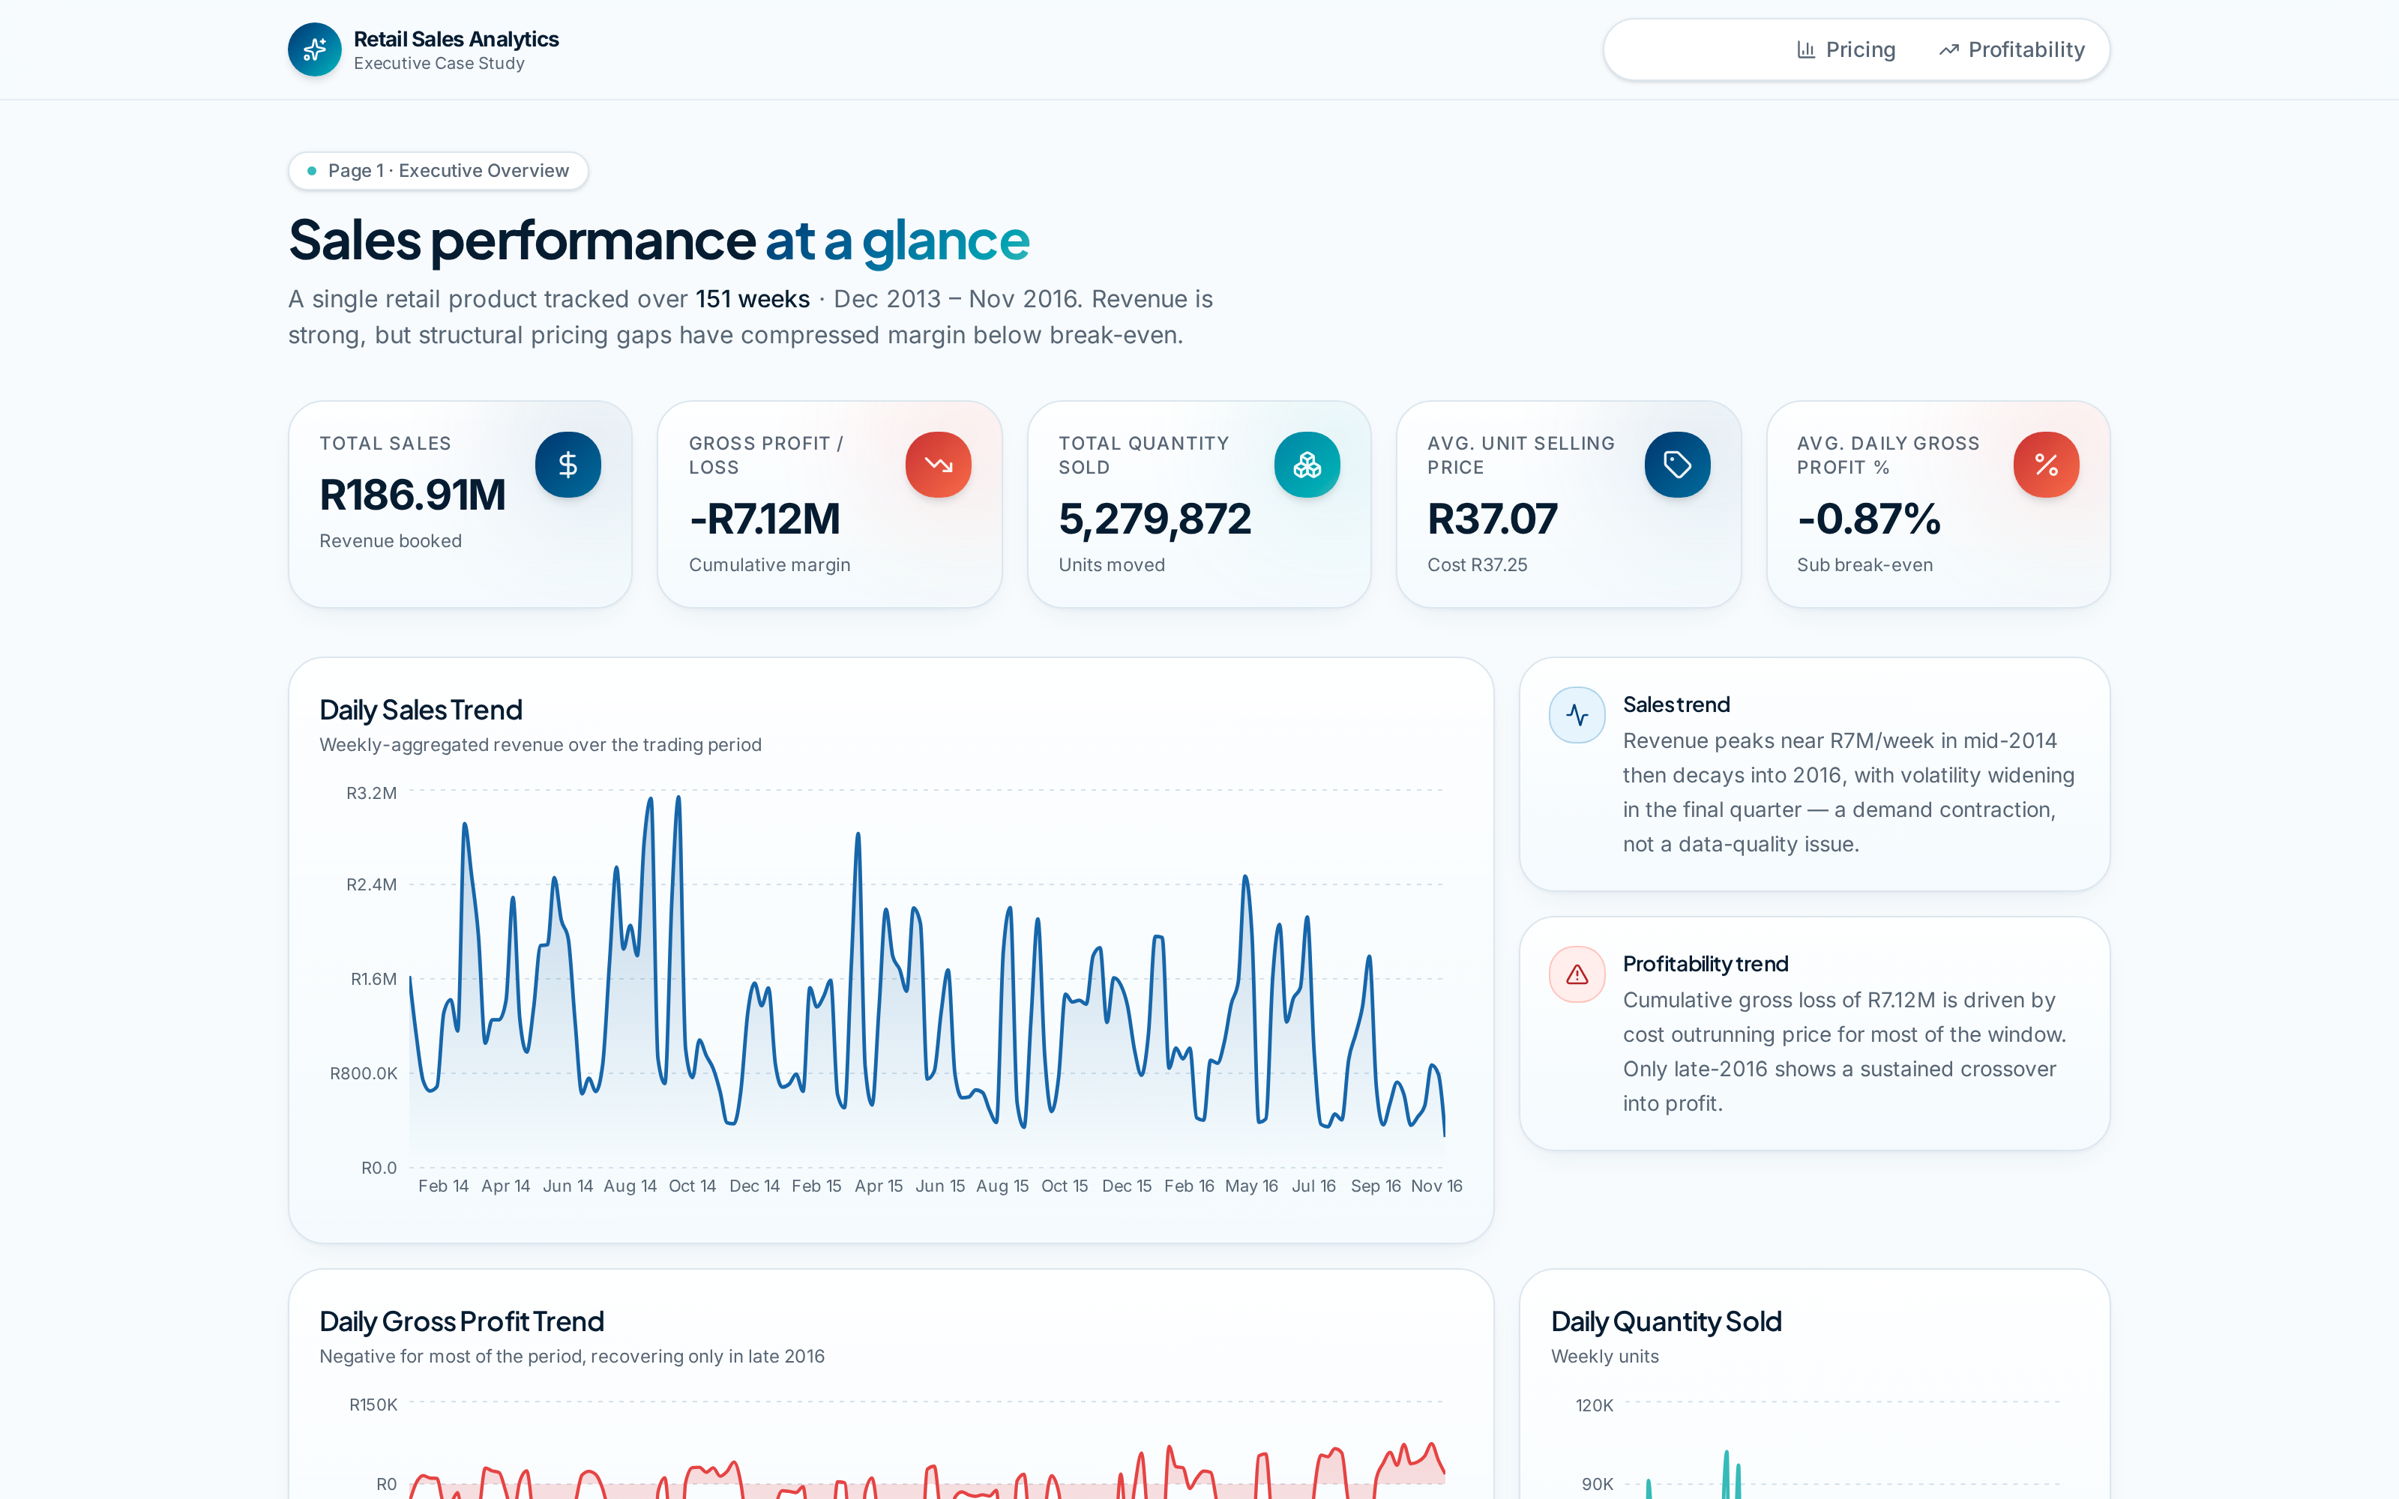
09 · PRODUCT
Interactive Dashboard
Built for decision-makers
Three-page narrative
Overview, pricing and profitability, sequenced like a board report.
Hover tooltips
Exact value and date on every chart point.
Cross-filtering
Year and month filters restate every pricing chart instantly.
Executive summary
Best and worst periods surfaced automatically from the data.
Responsive & animated
Framer Motion transitions, mobile-ready layouts.
React · TypeScript · Tailwind CSS · Recharts · Framer Motion
Sales Performance Analysis · Interactive Dashboard
10

Slide 11
10 · CAPABILITY
Skills Demonstrated
SQL
Excel
Data Cleaning
Exploratory Data Analysis
Dashboard Design
Aggregation & window queries
Validation and pivot analysis
Integrity and outlier handling
Distribution & trend discovery
Executive layout systems
Data Storytelling
Business Intelligence
KPI Development
Pricing Analysis
Data Visualisation
Narrative-led reporting
Decision-ready reporting
Metric definition & derivation
Price, cost and elasticity
Recharts & visual encoding
Applied end-to-end on this case study: raw daily extract → validated dataset → derived KPIs → interactive executive dashboard.
Sales Performance Analysis · Skills Demonstrated
11

Slide 12
LINKEDIN
[ADD YOUR LINKEDIN URL]
Thank you
GITHUB
[ADD YOUR GITHUB URL]
Questions and feedback are welcome — the full interactive dashboard is available online.
PORTFOLIO
sales-case-study-dashboard.lovable.app
EMAIL
[ADD YOUR EMAIL]
Sales Performance Analysis · Data Analytics Case Study

